Slide 1
Mean Stack

Slide 2
Introduction
MEAN is a free and open-source JavaScript software stack for building dynamic websites and web applications or we can say that MEAN stack is a collection of JavaScript-based technologies used to develop web applications.
MEAN is an acronym for MongoDB, ExpressJS, AngularJS, and Node.js. From client to server to database, MEAN is full-stack JavaScript.

Slide 3
Introduction
M = MongoDB, a popular database manager which implements a NoSQL structure.
E = Express.js, a framework that supports and is used to host Node.js projects.
A = Angular.js, yet another framework for building apps. It builds upon the classic HTML framework style and extends it to web apps
N = Node.js is a runtime environment, which runs server-side web applications, i.e. it works on the back-end, away from the user’s eyes to fetch relevant data or perform operations on the same.

Slide 4
Introduction
MongoDB offers a more flexible, accommodating layer for storing data.
Node.js provides a better nexus for running your server, while Express.js helps to standardize how you build your websites.
On the client-side, AngularJS provides a clean way of adding interactive functions and AJAX-driven rich components. The amalgamation of all makes a clean, coherent mechanism for moving data from the user to the disk farm and back again.

Slide 5
Features of MEAN Stack Architecture
One of the most important benefits of all is that it lets the developer write the entire code in JavaScript; from client to server.
It is like a blessing for the JavaScript developers who have invested their time and money in learning JavaScript for the client-side tasks.

Slide 6
Features of MEAN Stack Architecture
The MEAN components are open source; in other words, the stack gets updated regularly. In addition to this, it is easy to use, flexible to understand and moreover assists the developers to customize as per the requirements.
A massive module library of node.js and the use of JSON to transfer the data are a few other features of MEAN.
Not just the start-ups but also big companies like Walmart, PayPal, Yahoo, Netflix, Uber, LinkedIn, etc. have also shifted to Node.js

Slide 7
Uses of MEAN
Because of its enhanced scalable and handling capacity of concurrent users, it is much more favored for developing cloud-native applications.
Though MEAN stack is not ideal for every application there are other uses where it easily offsets. AngularJS helps to develop SPAs (single-page applications) which normally includes all the information or functionalities for the user on a single page. Most common examples are as follows:
Calendars
Expense Tracking
Mapping & location tracking
News

Slide 8
MEAN Stack Architecture
MEAN is a free and open-source JavaScript software stack for building dynamic websites and web apps. It is very simple & easy to use for both back-end and front-end.
In other technologies, there are different languages used for front and back-end but however, MEAN is written in one language for both server-side and client-side execution.

Slide 9
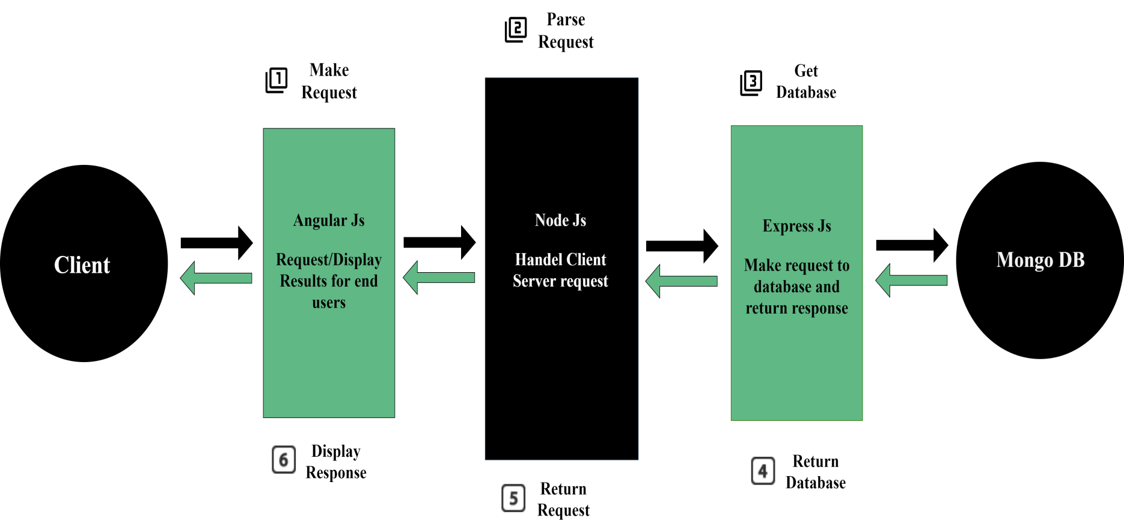
MEAN Stack Architecture
Working of MEAN Stack is explained :

Slide 10
MEAN Stack Architecture
When the client makes any request it is firstly processed by the AngularJS. AngularJS is a client-side language in JavaScript.
After that, the request enters phase 2 which is NodeJS. NodeJS is a server-side language in JavaScript.
In phase 3, which is ExpressJS makes the request to the database.
MongoDB retrieves the data & returns the response back to the ExpressJS.
Then ExpressJS sends a response back to the NodeJS and then NodeJS forwards it to the AngularJS to display the result.

Slide 11
AngularJS (Client-Side)
AngularJS is a structural framework for dynamic web apps. It lets you use HTML as your template language and allows you to extend HTML’s syntax to express your application’s components clearly and succinctly.
AngularJS is a browser-independent powerful JavaScript-based data binding UI framework to create RICH Internet Application(RIA).
It provides developers with options to write a client-side application (using JavaScript) in a clean MVC (Model View Controller)
An open-source, completely free, and used by thousands of developers around the world. It is licensed under the Apache License version 2.0.

Slide 12
MVC
Model
It is the lowest level of pattern responsible for maintaining data.
The model is responsible for managing application data. It responds to the request from view and to the instructions from the controller to update itself.
The Model component corresponds to all the data-related logic that the user works with. This can represent either the data that is being transferred between the View and Controller components or any other business logic-related data. For example, a Customer object will retrieve the customer information from the database, manipulate it and update it data back to the database or use it to render data.

Slide 13
MVC
View
It is responsible for displaying all or a portion of data to the user.
A presentation of data in a particular format, triggered by the controller’s decision to present the data. They are script-based template systems such as JSP, ASP, PHP and very easy to integrate with AJAX technology.
The View component is used for all the UI logic of the application. For example, the Customer view will include all the UI components such as text boxes, dropdowns, etc. that the final user interacts with.

Slide 14
MVC
Controller
It is a software Code that controls the interactions between the Model and View.
The controller responds to user input and performs interactions on the data model objects. The controller receives input, validates it, and then performs business operations that modify the state of the data model.
Controllers act as an interface between Model and View components to process all the business logic and incoming requests, manipulate data using the Model component and interact with the Views to render the final output. For example, the Customer controller will handle all the interactions and inputs from the Customer View and update the database using the Customer Model. The same controller will be used to view the Customer data.

Slide 15
NodeJS (Server Side)
Node.js is a server-side platform built on Chrome’s JavaScript runtime to easily build fast and scalable network applications.
Node.js uses an event-driven, non-blocking I/O model that makes it lightweight and efficient, hence, perfect for data-intensive real-time applications that run across distributed devices.
1) Asynchronous and Event-Driven
All APIs of Node.js library is asynchronous, that is, non-blocking. It essentially means a Node.js based server never waits for an API to return data. The server moves to the next API after calling it and a notification mechanism of Events of Node.js helps the server to get a response from the previous API call.

Slide 16
NodeJS (Server Side)
2) Very Fast
Being built on Google Chrome’s V8 JavaScript Engine, Node.js library is very fast in code execution. Moreover, with its runtime feature, one can easily build scalable and secure web apps.
3) Single-Threaded but Highly Scalable
Node.js uses a single-threaded model with event looping. The event mechanism helps the server to respond in a non-blocking way and makes the server highly scalable as opposed to traditional servers which create limited threads to handle requests. Node.js uses a single-threaded program and the same program can provide service to a much larger number of requests than traditional servers like Apache HTTP Server.

Slide 17
NodeJS (Server Side)
4) Buffering
A stream of data can be classified as the movement of the data from one point to another with a function of either to process or read it and make decisions accordingly.
Depending upon the flow of data through a stream either the process will consume the data faster and needs to wait for the excess data or if it is slower than it needs to wait for additional data to arrive before it is being sent out for processing.
Whichever is the scenario, the waiting area is the ‘Buffer’. Node.js does not hold the control over the speed, time of data arrival or the speed of the stream however, it can only act on the time to send out the data.

Slide 18
NodeJS (Server Side)
Threading
Node.js operates on a single thread, using non-blocking I/O calls, allowing it to support tens of thousands of concurrent connections without incurring the cost of thread context switching.
The design of sharing a single thread between all the requests that use the observer pattern is intended for building highly concurrent applications, where any function performing I/O must use a callback.

Slide 19
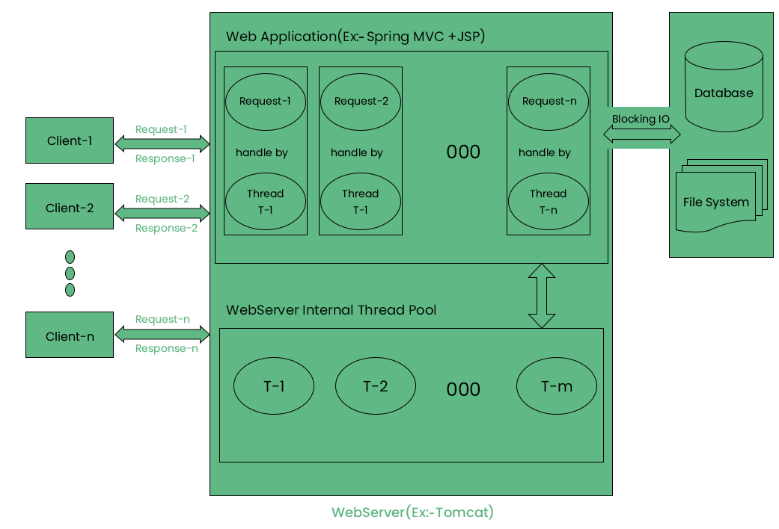
NodeJS (Server Side)

Slide 20
ExpressJS
Express provides a minimal interface for us to build our applications. Providing with absolutely necessary tools to build our app with flexibility.
Numerous modules available on npm for express, which can be directly plugged into an express.
Database integration, template engines, and basic multiple routing can be performed. It not only helps middleware to respond to HTTP requests but also helps to dynamically render HTML pages by passing arguments to templates.
Unlike its competitors like Rails and Django, which have an opinionated way of building applications, express has no “best way” to do something. It is very flexible and pluggable.

Slide 21
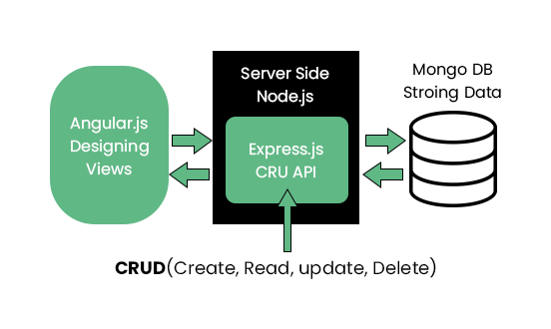
ExpressJS
When the user sends a request through AngularJS then that request is firstly accessed by the NodeJS.
Threading is done in the NodeJS and then it is sent to the ExpressJS to Create, Read, Update and Delete the API for the request.
ExpressJS hosts the website for the NodeJS. Both NodeJS and ExpressJS are server-side languages. After CURD, the API data is retrieved from the MongoDB and then send it to the User.

Slide 22
ExpressJS
CRUD Operations
Create (POST) – Make something
Read (GET)_- Get something
Update (PUT) – Change something
Delete (DELETE)- Remove something

Slide 23
MongoDB
MongoDB (from humongous) is a free and open-source, cross-platform document-oriented database program.
Classified as a NoSQL database program, MongoDB uses JSON-like documents with schemas.
MongoDB is the database for today’s applications, enabling you to:
Leverage data and technology to maximize competitive advantage
Reduce risk for mission-critical deployments
Accelerate time-to-value
A drastic reduction in the total cost of ownership
We can build applications using MongoDB databases without using traditional database relations (MYSQL).

Slide 24
MongoDB
MongoDB features are below:
1) Fast, Iterative Development
A flexible data model coupled with dynamic schema and idiomatic drivers makes it fast for developers to build and evolve applications.
2) Flexible Data Model.
MongoDB’s document data model makes it easy for you to store and combine data of any structure, without giving up sophisticated validation rules, data access and rich indexing functionality.
3) Multi-Datacentre Scalability
As your deployments grow in terms of data volume and throughput, MongoDB scales easily with no downtime, and without changing your application.

Slide 25
MongoDB
4) Integrated Feature Set
Analytics and data visualization, text search, graph processing, geospatial, in-memory performance, and global replication allow you to deliver a wide variety of real-time applications on one technology, reliably and securely.
5) Lower TCO
Application development teams are more productive when they use MongoDB. Single click management MEANs operations teams are as well. MongoDB runs on commodity hardware which in turn dramatically reduces the cost.

Slide 26
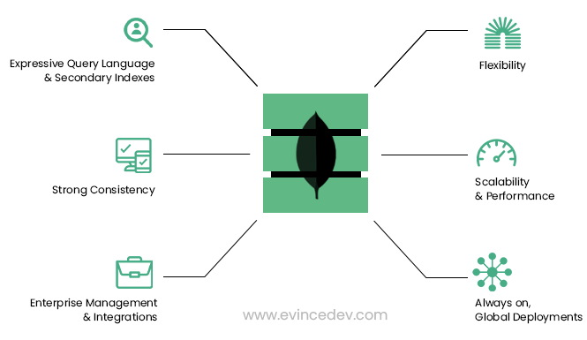
MongoDB

Slide 27
MongoDB
Architecture Description
1) Expressive query language & secondary Indexes.
Users should be able to access and manipulate their data in sophisticated ways to support both operational and analytical applications. Indexes play a critical role in providing efficient access to data, supported natively by the database rather than maintained in application code.
2) Strong consistency.
Applications should be able to immediately read what has been written to the database. It is much more complex to build applications around an eventually consistent model, imposing significant work on the developer, even for the most sophisticated engineering teams.

Slide 28
MongoDB
3) Enterprise Management and Integrations.
Databases are just one piece of application infrastructure and need to fit seamlessly into the enterprise IT stack. Organizations need a database that can be secured, monitored, automated, and integrated with their existing technology infrastructure, processes, staff including operations teams, DBAs, and data analysts.
However, modern applications impose requirements not addressed by relational databases, and this has driven the development of NoSQL (non SQL”, “non-relational” or “not only SQL) databases which offer:

Slide 29
MongoDB
4) Flexible Data Model.
NoSQL databases emerged to address the requirements for the data we see dominating modern applications. Whether document, graph, key-value, or wide-column, all of them offer a flexible data model, making it easy to store and combine data of any structure and allow dynamic modification of the schema without downtime or performance impact.
5) Scalability and Performance.
NoSQL databases were all built with a focus on scalability, so they all include some form of shading or partitioning. This allows the database to scale out on commodity hardware deployed on-premises or in the cloud, enabling almost unlimited growth with higher throughput and lower latency than relational databases.

Slide 30
MongoDB
6) Always-On Global Deployments.
NoSQL databases are designed for highly available systems that provide a consistent, high-quality experience for users all over the world.
They are designed to run across many nodes, including replication to automatically synchronize data across servers, racks, and data centers.

Slide 31
MongoDB
Features of MongoDB
In MongoDB, data represents a collection of JSON documents.
MongoDB’s querying is object-oriented, which means you can pass MongoDB a document explaining what you are querying. MongoDB doesn’t support joints, however, it does support multi-dimensional data types like other documents and arrays.
MongoDB, you will only have one array of comments and one collection of posts within a post
One of the best things about MongoDB is that you are not responsible for defining the schema

Slide 32
Thank You

